Slide 1
COMPARE OBJECTS

Slide 3
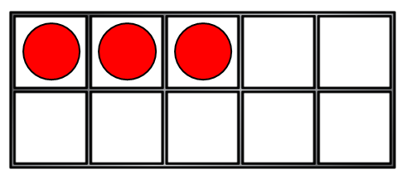
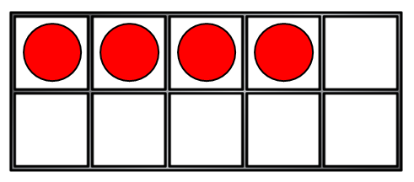
Which has more?
or
or
or

Slide 5
Less than, equal to or greater than
$$< = >$$
Have a think
$$=$$
$$>$$
$$<$$
$$=$$
10
10

Slide 6
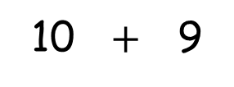
Less than, equal to or greater than
$$< = >$$
Have a think
$$=$$
$$>$$
$$<$$
$$<$$
10
10 $+$ 9
1 | 2 | 3 | 4 | 5 | 6 | 7 | 8 | 9 | 10 | 11 | 12 | 13 | 14 | 15 | 16 | 17 | 18 | 19

Slide 7
Less than, equal to or greater than
$$< = >$$
Have a think
$$<$$
$$=$$
$$>$$
$$>$$
11
10
1 | 2 | 3 | 4 | 5 | 6 | 7 | 8 | 9 | 10 | 11 | 12 | 13 | 14 | 15 | 16 | 17 | 18 | 19

Slide 8
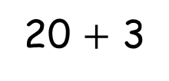
Less than, equal to or greater than
$$< = >$$
Have a think
$$<$$
$$=$$
$$>$$
$$>$$
25
20 $+$ 3
21 | 22 | 23 | 24 | 25 | 26 | 27 | 28 | 29

Slide 9
Have a go at the worksheet

