Slide 1
Thursday 25th February
SOUND WAVES

Slide 2
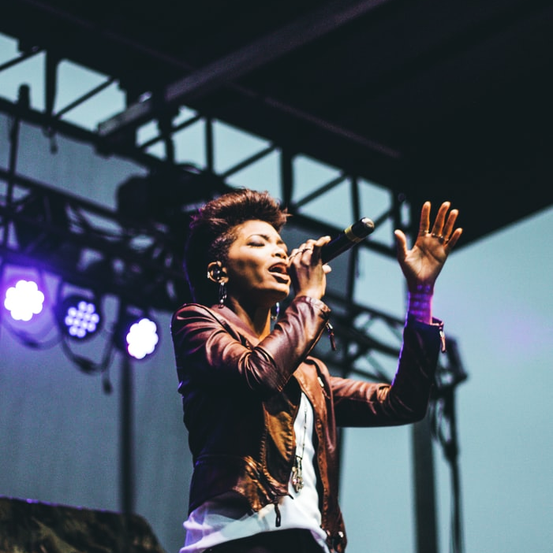
HELLO!
Think about what you already know about sound and hearing.
Can you tell someone 10 quick facts ?

Slide 3
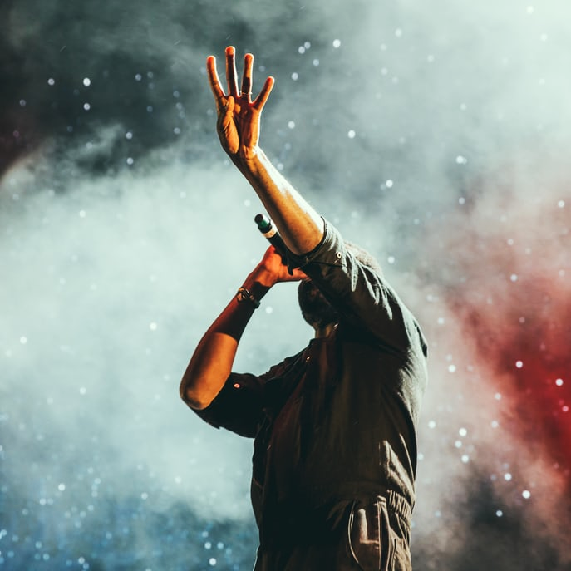
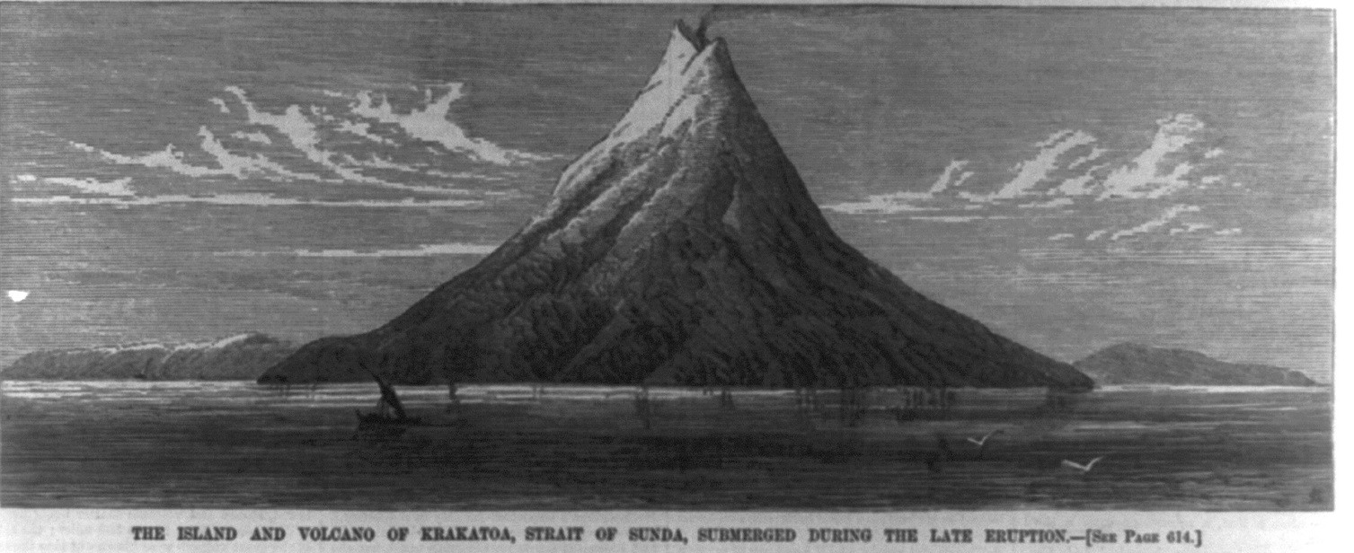
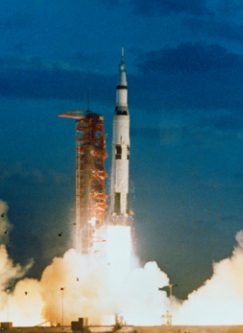
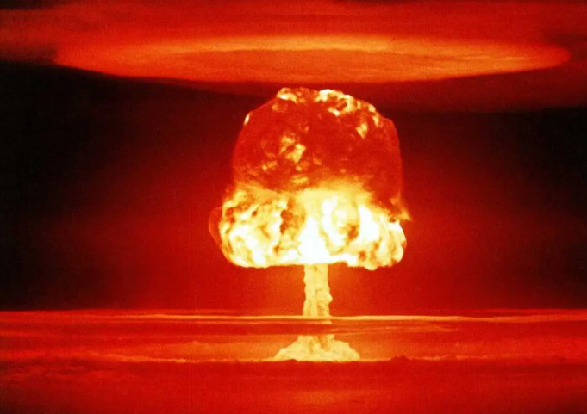
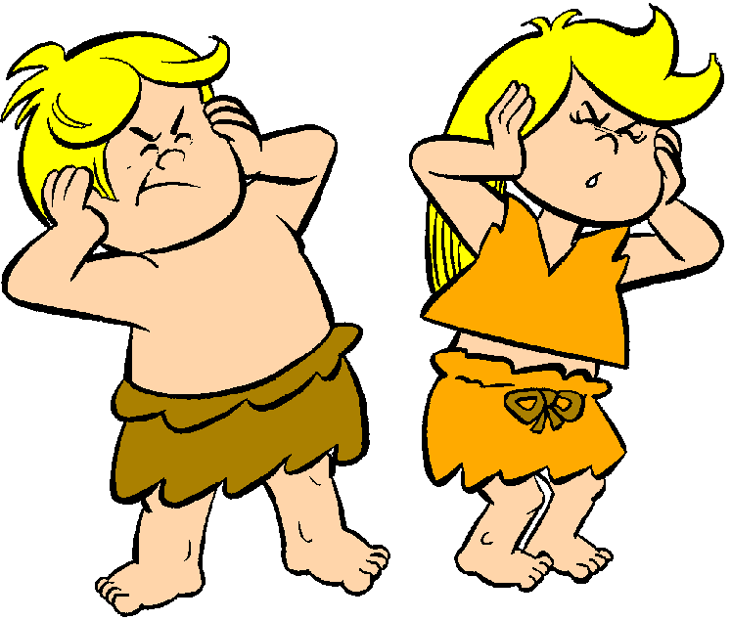
4 FACTS ABOUT LOUD SOUNDS
NASA’s highest recorded decibel reading was 204 decibels when the Saturn Five rocket blasted off to the moon!
The Loudest Natural Sound ever recorded was in 1883 when the ancient Indonesian volcano Krakatoa exploded!
It was 310 decibels.
The loudest ever man-made sound was 250 decibels. This was created by the detonation of an atomic bomb in World War Two.
310 decibels is loud enough to kill you.
Your ear-drums would explode above 200 decibels!

Slide 4
FOCUS FOR THE DAY
Knowing that sounds travel in waves.
The size (amplitude) of a sound wave is proportional to the energy and therefore the volume of the sound.
The rate of occurrence (frequency) of a sound wave is recognizable as the pitch of the sound that we hear.

Slide 5
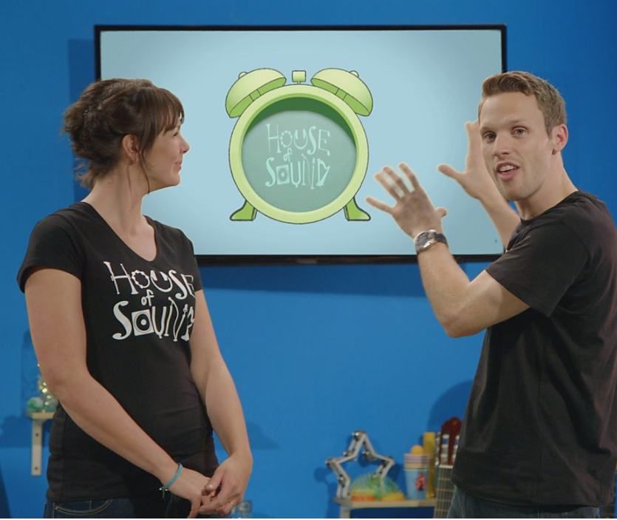
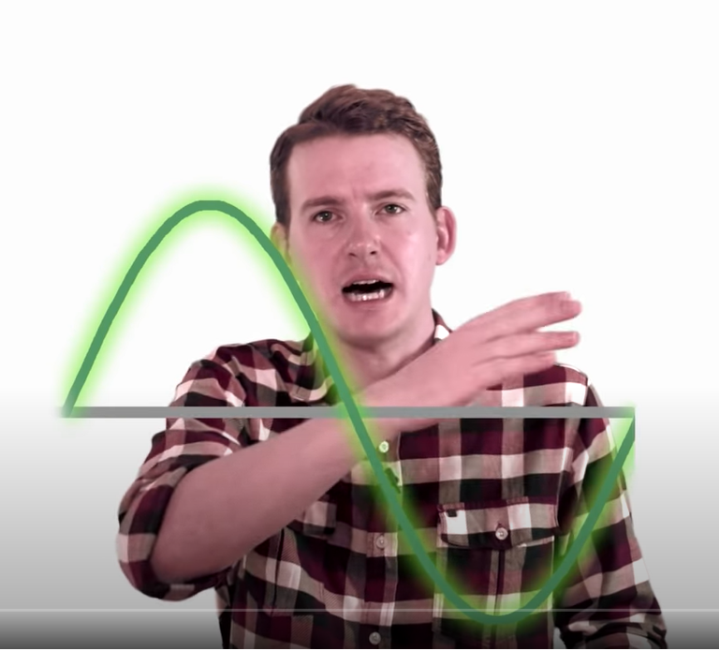
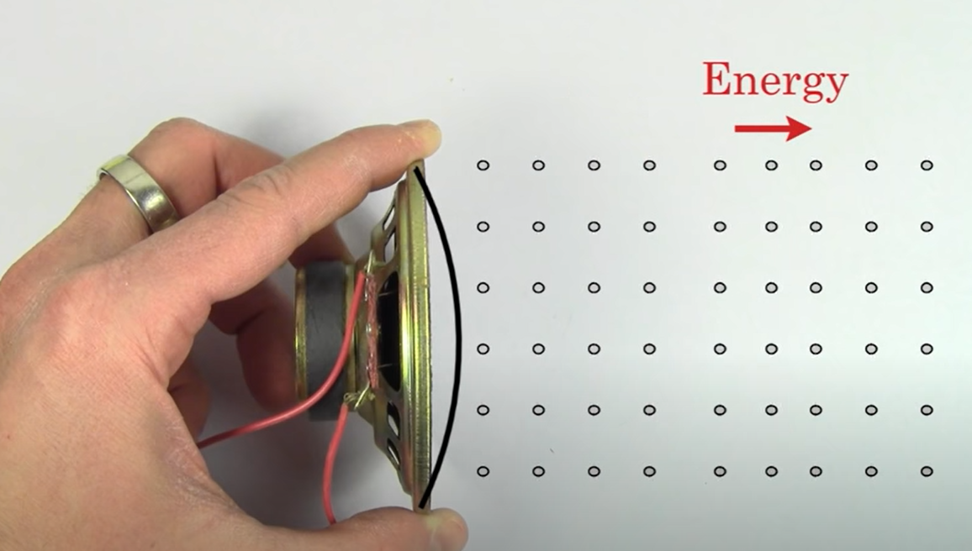
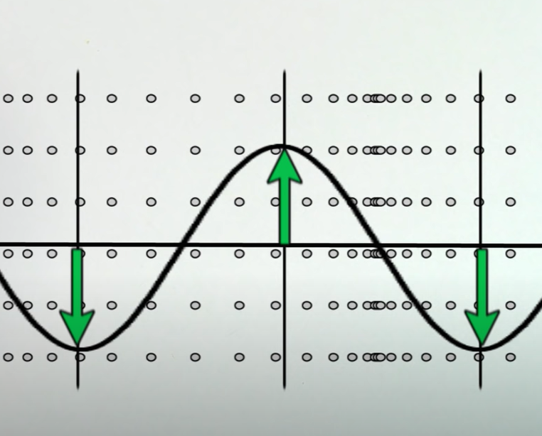
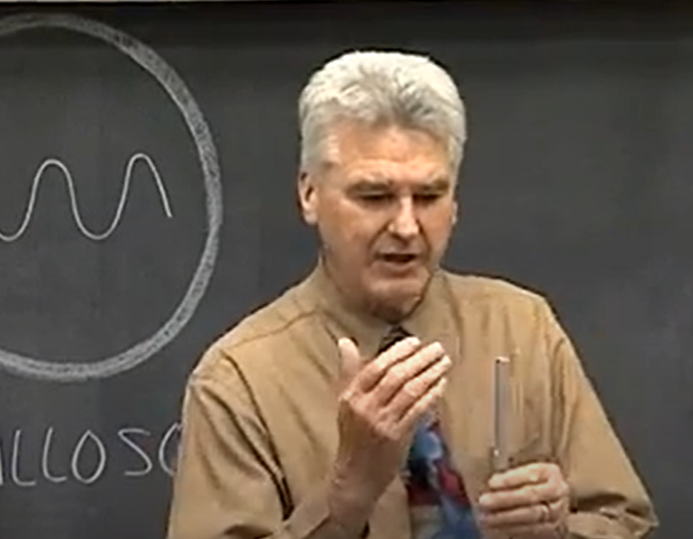
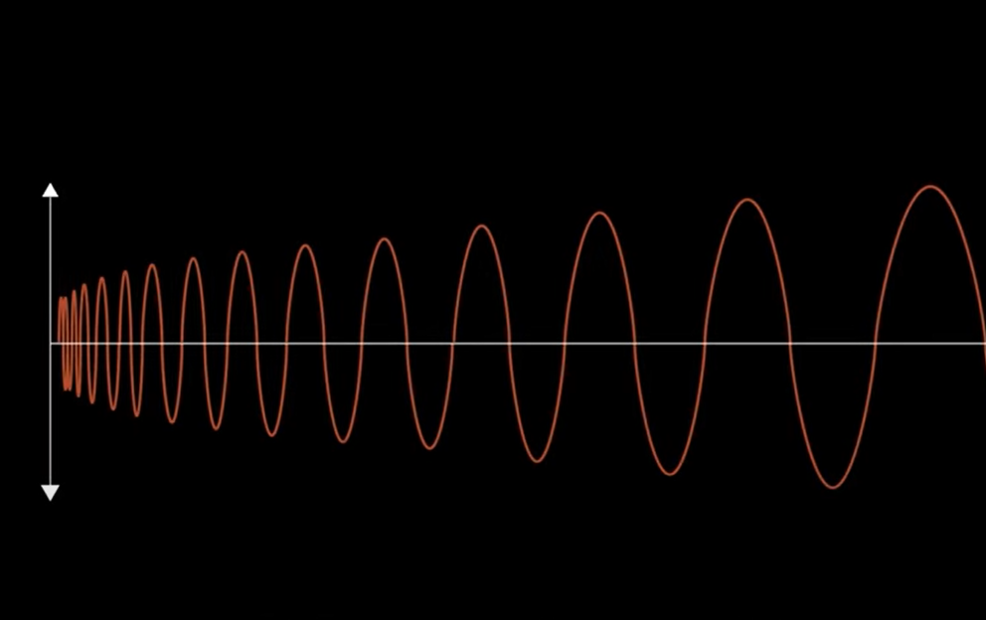
Drawing Sound-Waves
What do sounds look like ? Click on the videos below to find out.
BBC Bitesize
What
is
sound?
video
Sound Waves
Frequency
and
Amplitude Video
Khan Academy
Introduction to Sound video
Khan Academy
Wave Amplitude and Frequency
Video
(lots of vocabulary!)
Classic
Frequency
and
Amplitude
Lecture
Examples
of
Wave-forms
Click in order:
1 2 3 5 6
4

Slide 6

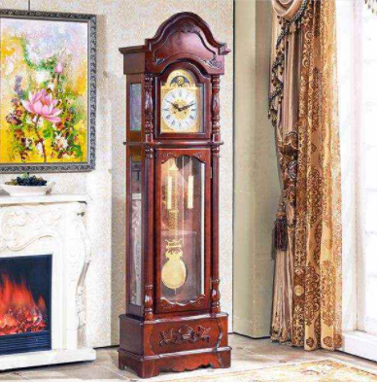
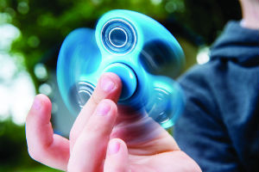
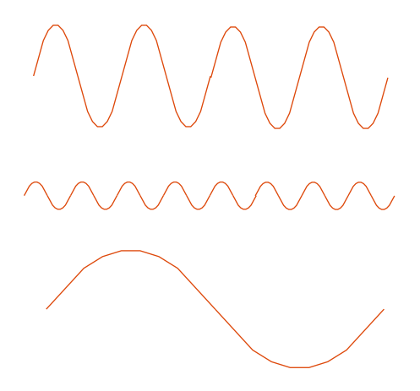
Medium Frequency
Low Frequency
High
Frequency
Match the wave to the turning object.
HINT: Think about the amplitude (volume) too!

Slide 7
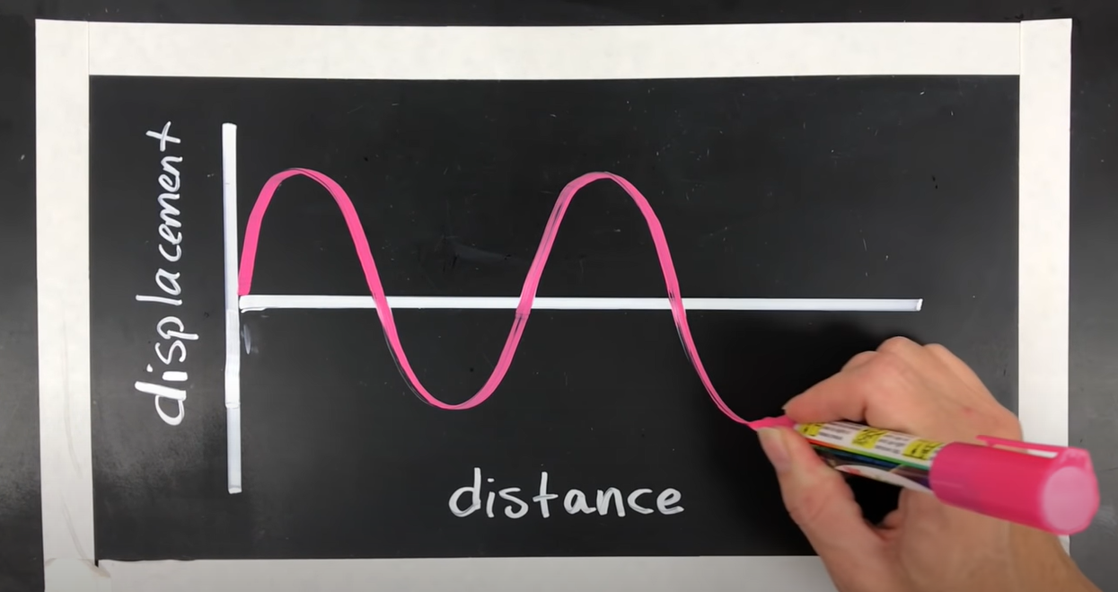
Today, you are going to have a go at drawing sound waves.

Slide 8
BIG CONCEPT
Simple hand-movements are the key to capturing the motion !
A wave drawing shows the movement of one particle over time.

Slide 9
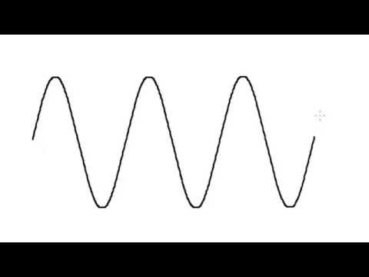
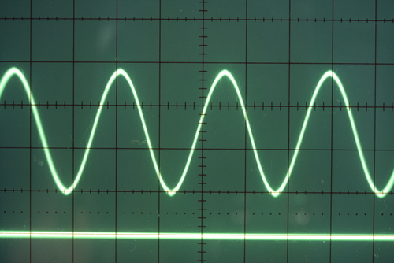
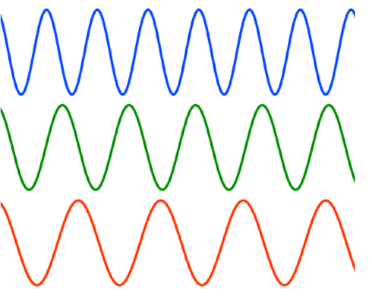
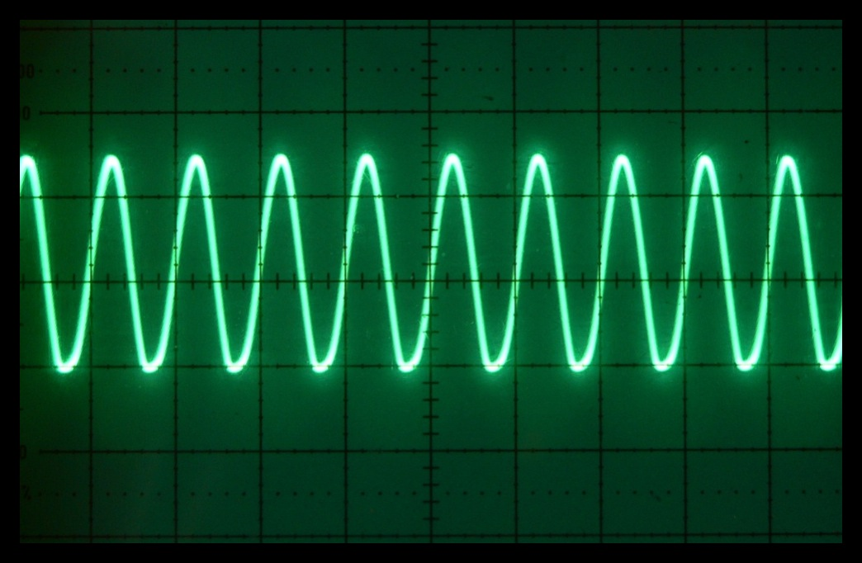
Concentrate on drawing a symmetrical wave.
Use some different colour pens or pencils to practise drawing sound waves.
Remember to use smooth hand-motions.

Slide 10
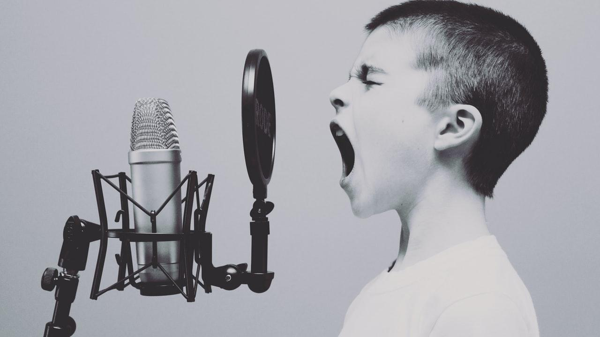
How Loud ?
What frequency?

Slide 11

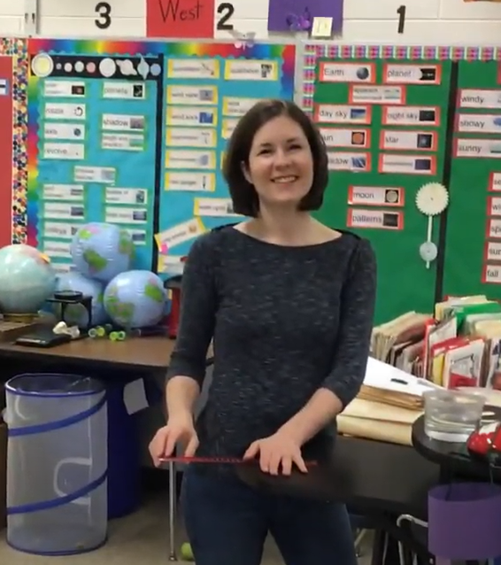

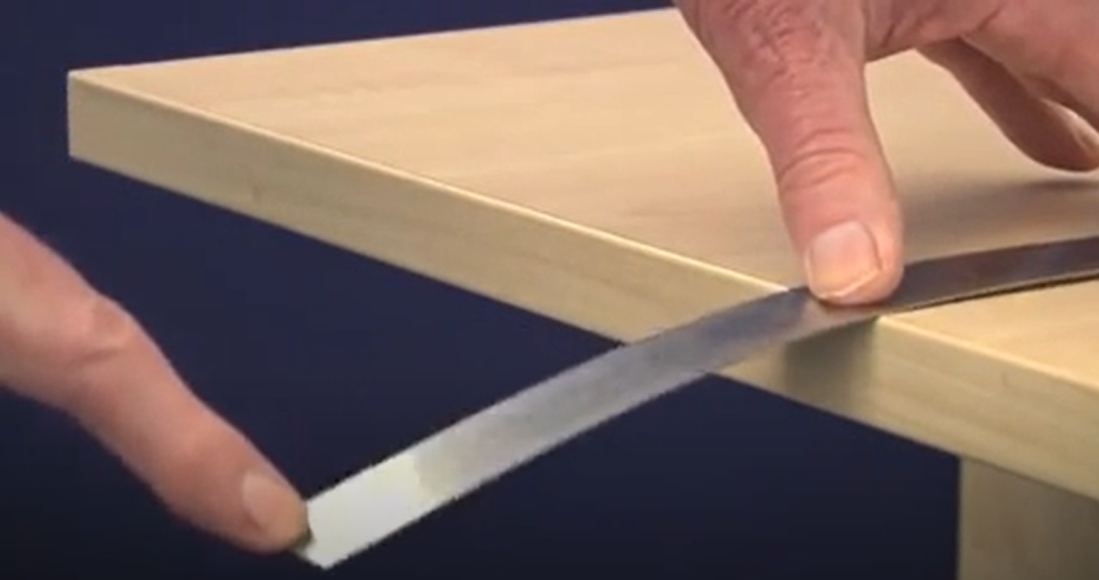
Take a look at today’s experiement:
Plucking a ruler on a counter.
Sound is vibration*
Ruler Demo.
(US Classroom)
Pitch Experiemtent using a ruler.
Vibrations of a steel ruler.

Slide 12
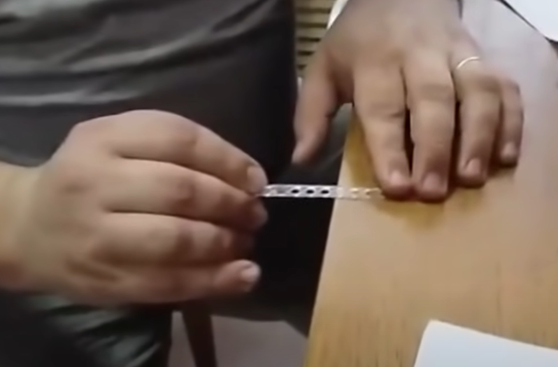
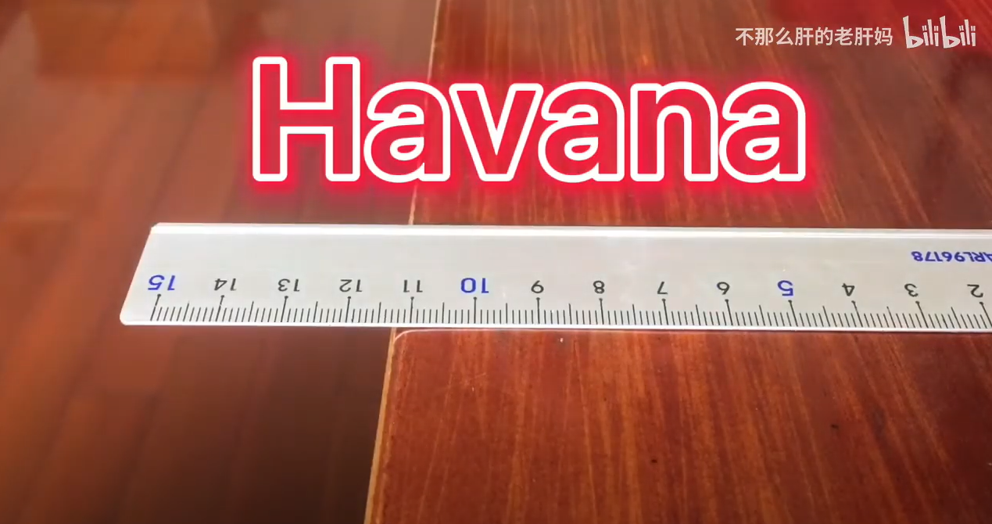
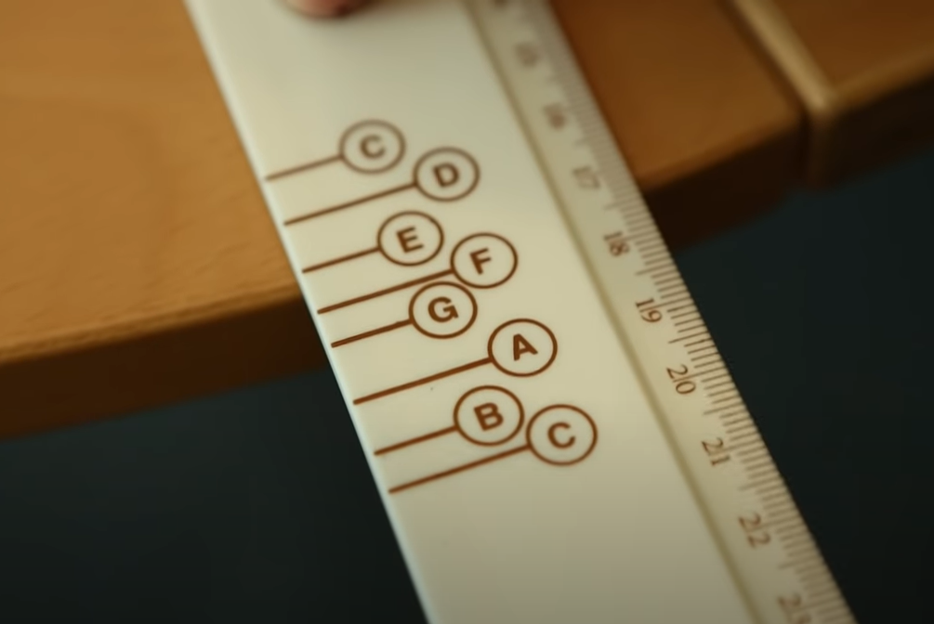
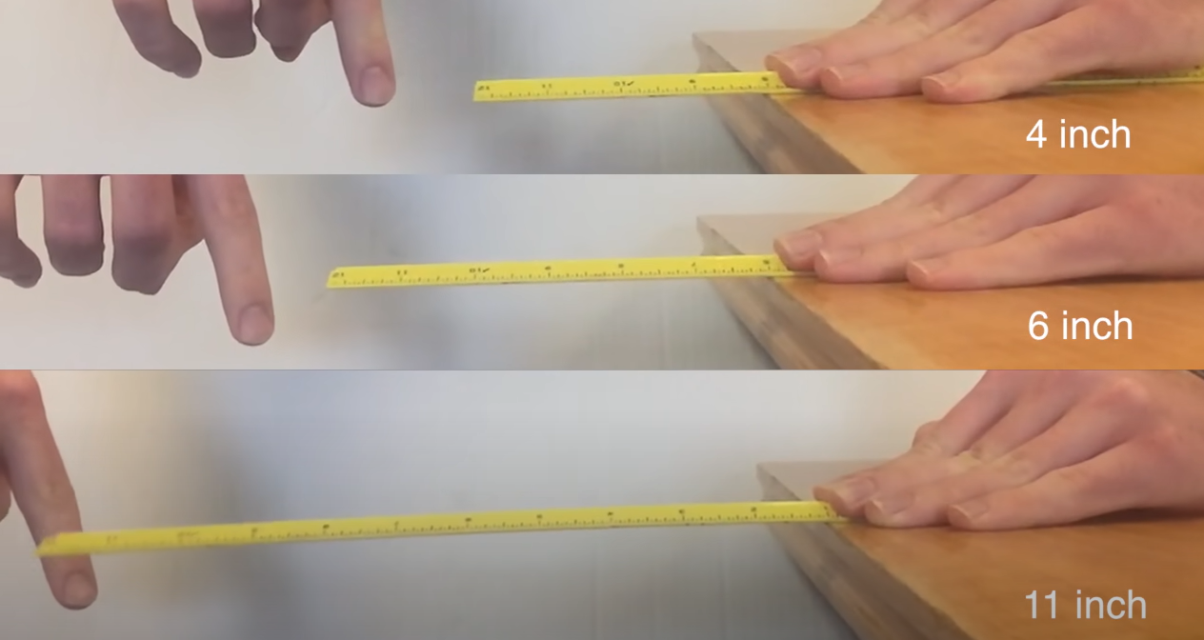
Listen to these tunes . . .
Can you hear the different frequencies ?
Star Wars - Imperial March played on a coffee stirrer!
Playing Havana on a steel ruler!
Beethoven on a musical ruler!
Slow Motion Ruler Vibrations

Slide 13
GET READY TO DRAW SOME SOUND WAVES
Remember this teacher ?
Classic
Frequency
and
Amplitude
Lecture

Slide 14
Going Live!
https://heamoor-community.eschools.co.uk/website/science_week_-_sound_wb_22022021/543399
Thursday 25th February 10:45am
Google Classroom
Join in with our fun wave-drawing activities!
DOWNLOAD THE WORKSHEET

Slide 15
Upload a picture!
Which sound wave is your favourite?
100%
Save your work in your Portfolio on Dojo.
Talk or write about one of the waves you have drawn.
Great success! You tried your best!

Slide 16
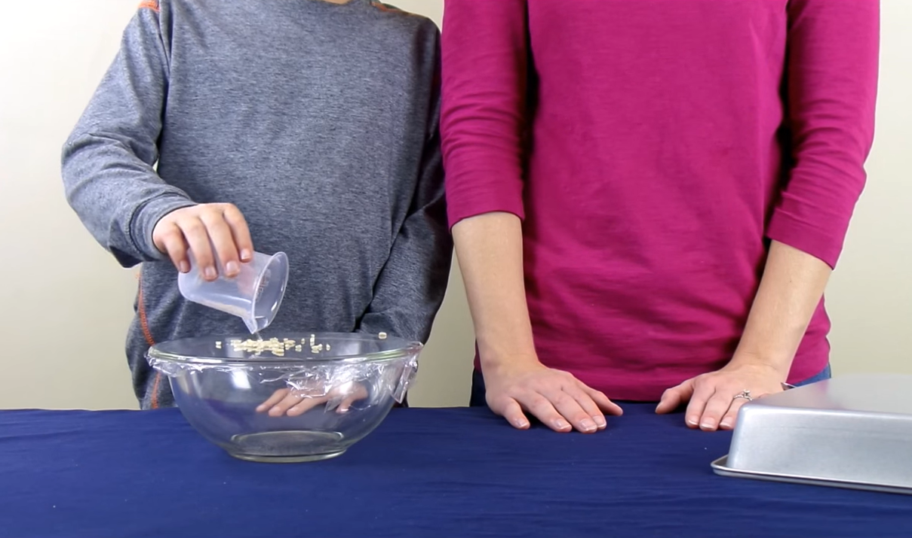
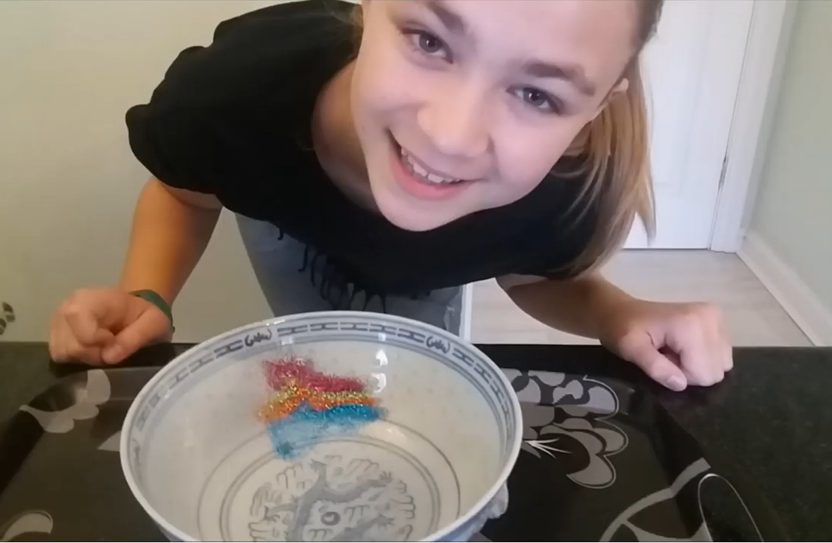
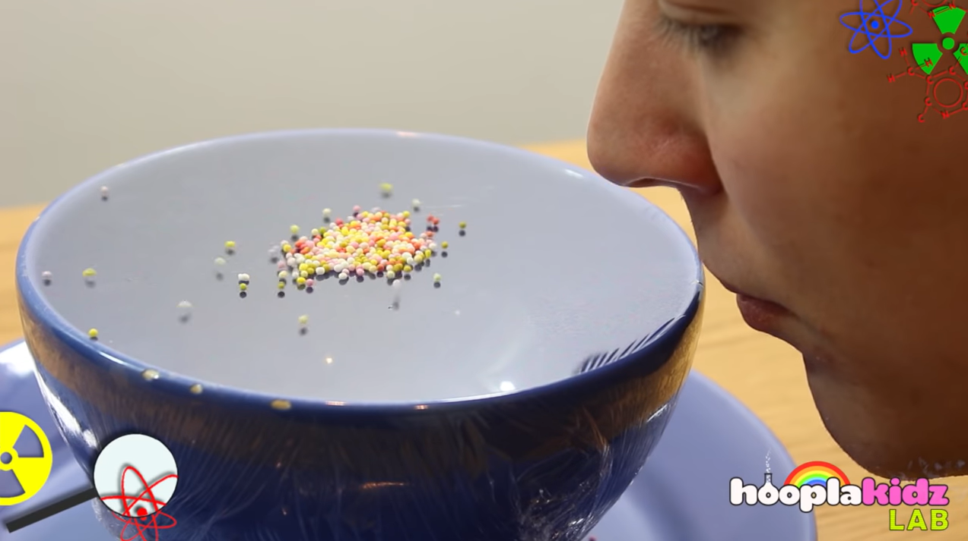
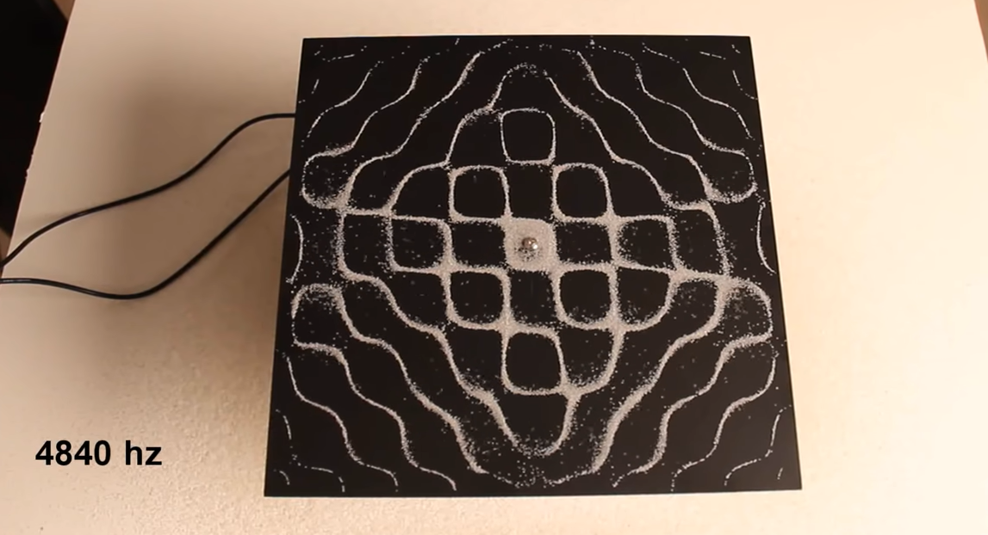
Experiment Two – Seeing Sound Waves Move Objects
Click on each picture to watch a video about moving objects with sound.
Have a go at making your own sound viewer !

Slide 17
Upload a picture or short video!
What worked well ?
Save your work in your Portfolio on Dojo.
What would you change ?
Talk or write about the ‘seeing sounds ’ experiment.

Slide 18
THANKS!
Any questions?
Send Mr. Fletcher a message on Dojo

Slide 19
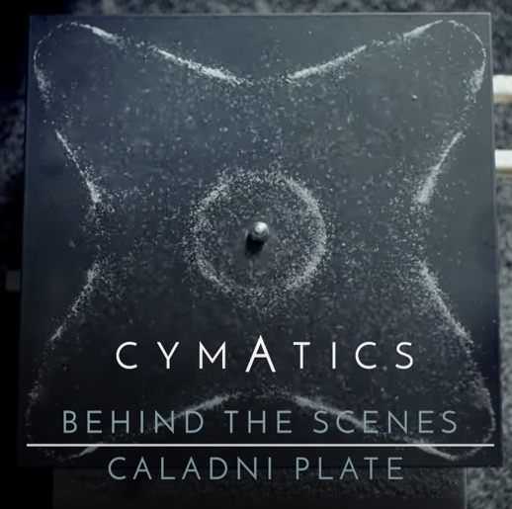
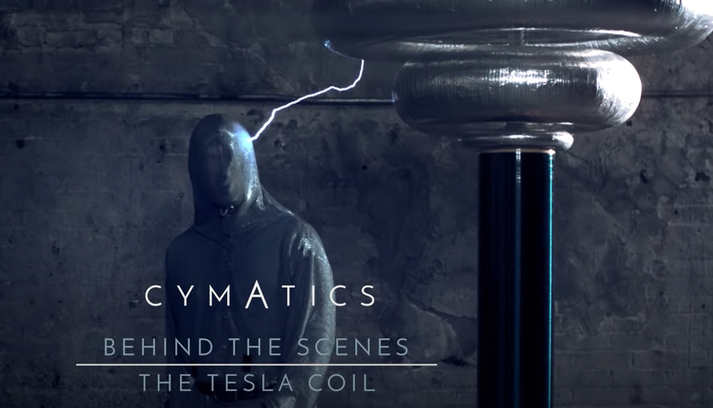
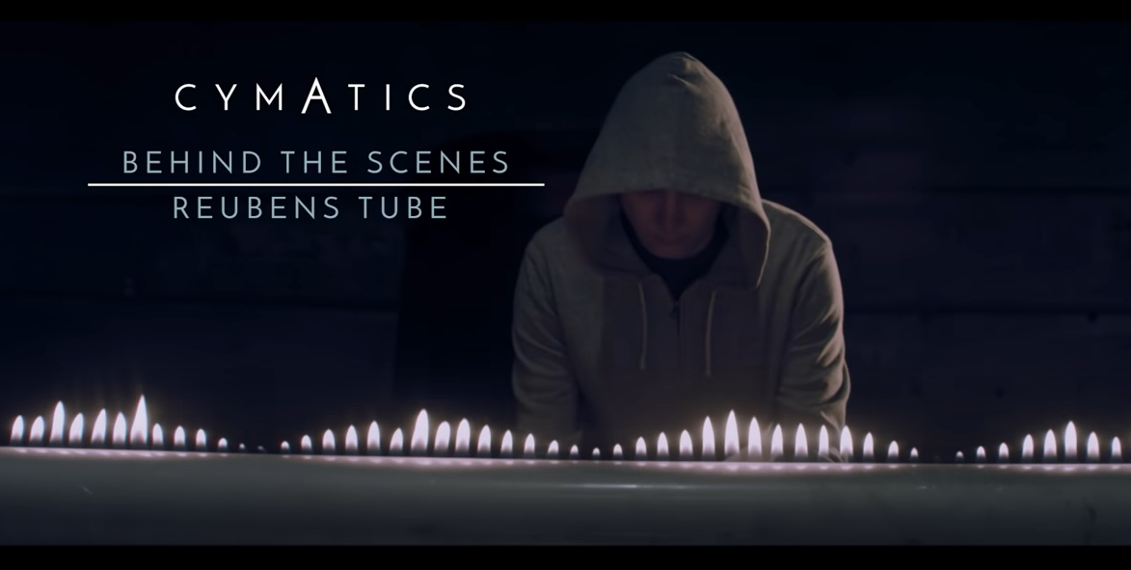
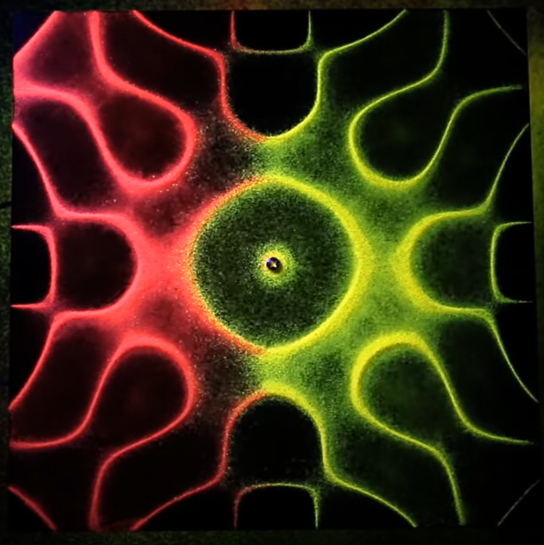
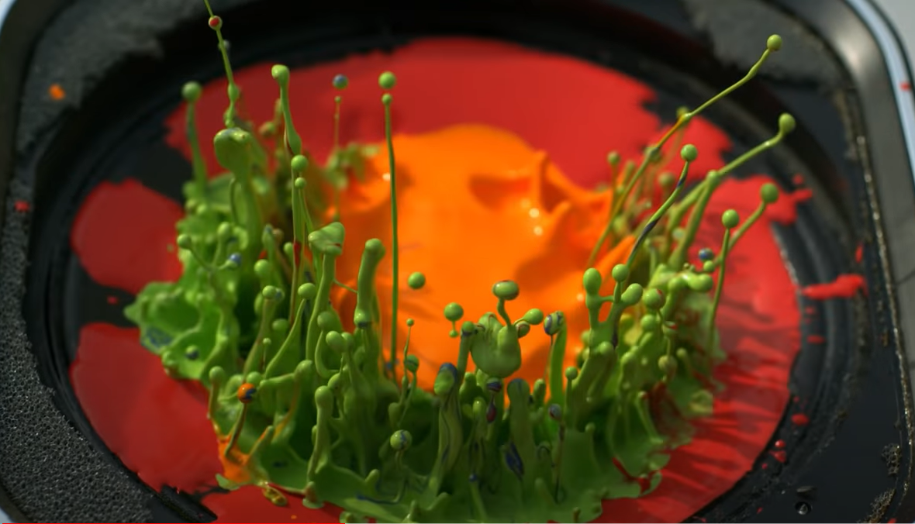
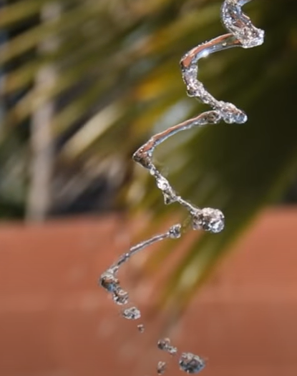
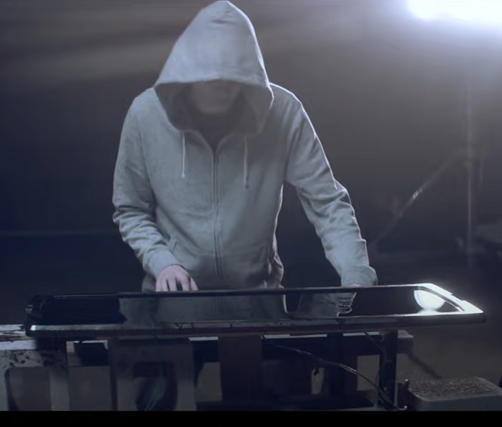
JUST FOR FUN !

Slide 20
I hope you enjoyed the lesson !
See you tomorrow at 10:45am on Google Classroom

