Slide 1
Sound Science Research Task

Slide 2
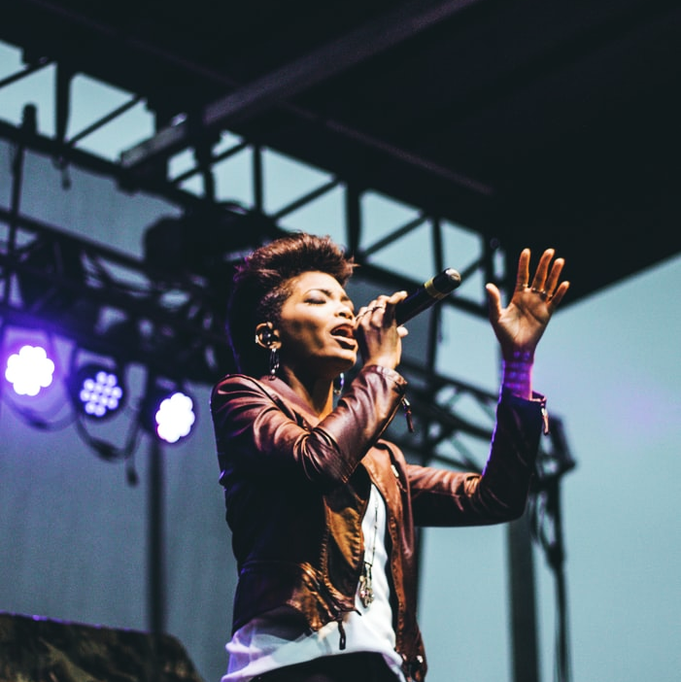
WELCOME BACK!
Friday 26th February
You can record findings in your writing book,
or
download today’s worksheet.

Slide 3
Amazing Sounds!
Today, we’re going to find out some astonishing facts by:
Reading information and Watching videos

Slide 4
Each video clip gives you a lot of general information.
The reading passages contain key facts too.
USE THEM BOTH TO WRITE A SHORT SUMMARY ABOUT EACH ITEM

Slide 5
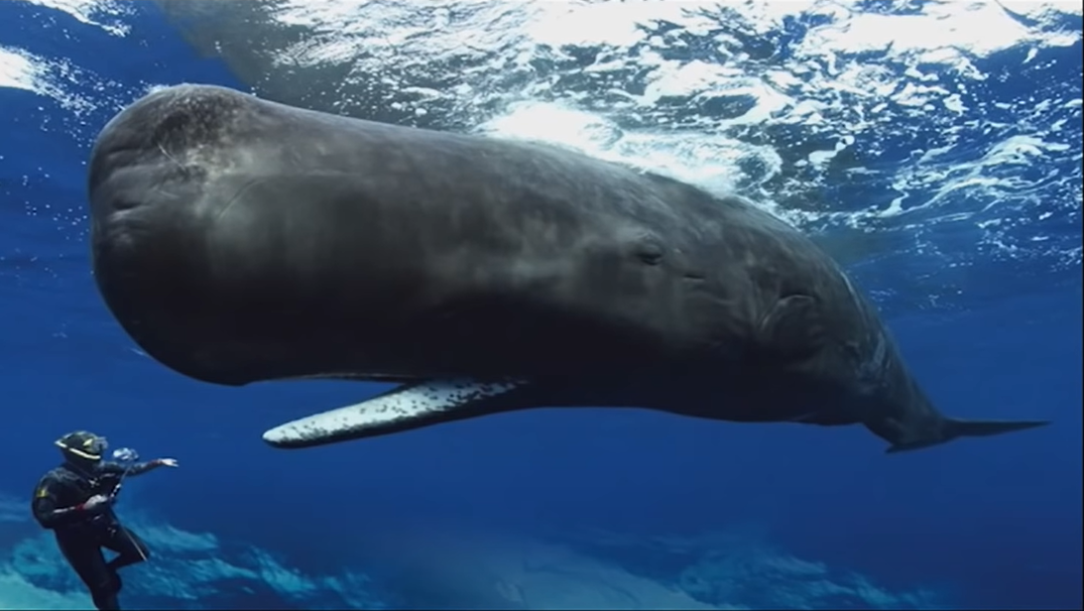
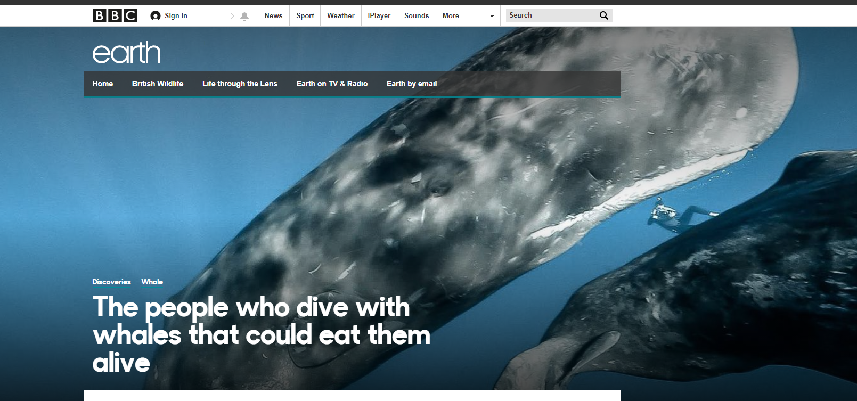
Research The Sound Science Behind Each Item
Quick Video
Sperm Whale
Research online yourself
Reading

Slide 6
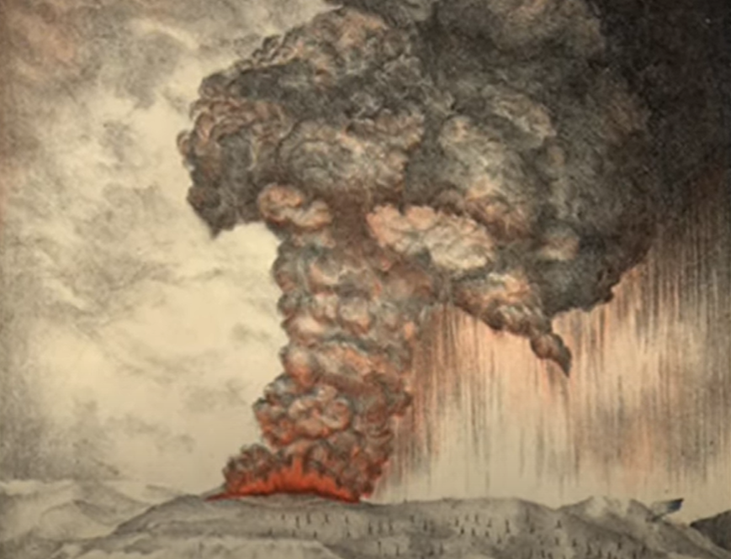
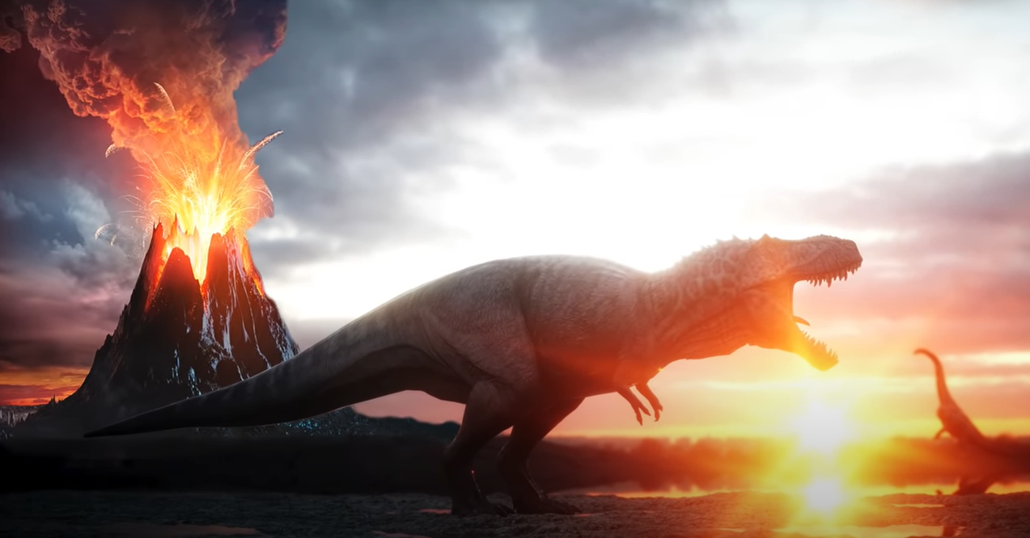
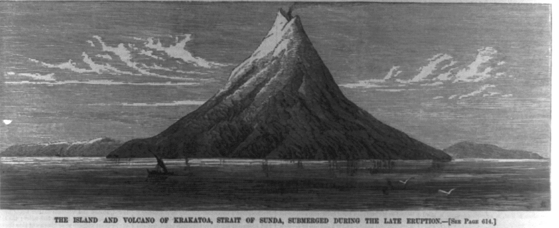
Quick Video on Krakatoa
Volcano Facts Video
Reading about the blast !
Research online yourself

Slide 7
Remember in your writing:
Capital Letters and full-stops.
Exclamation marks for amazing facts !
High quality sentences with key facts, figures and dates.
Try using a ‘Did you know that…?’ question to blow the reader away with an outstanding piece of information!

Slide 8
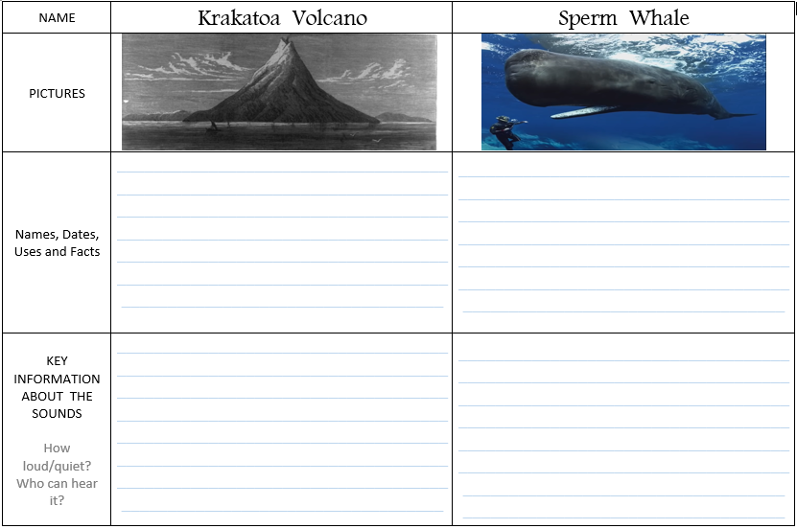
LI: I can summarise information
Aim for your best writing.
Keep your tall and short letters clear.
Use commas to separate the parts (clauses) in your sentences.

Slide 9
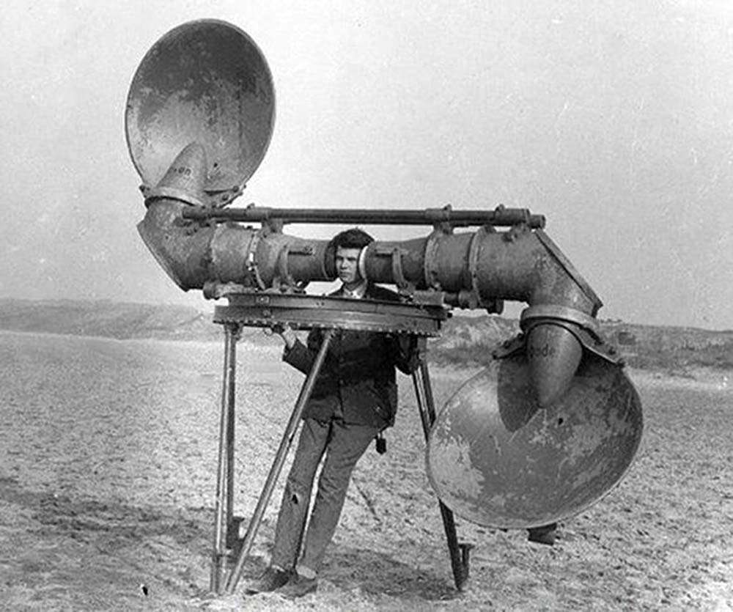
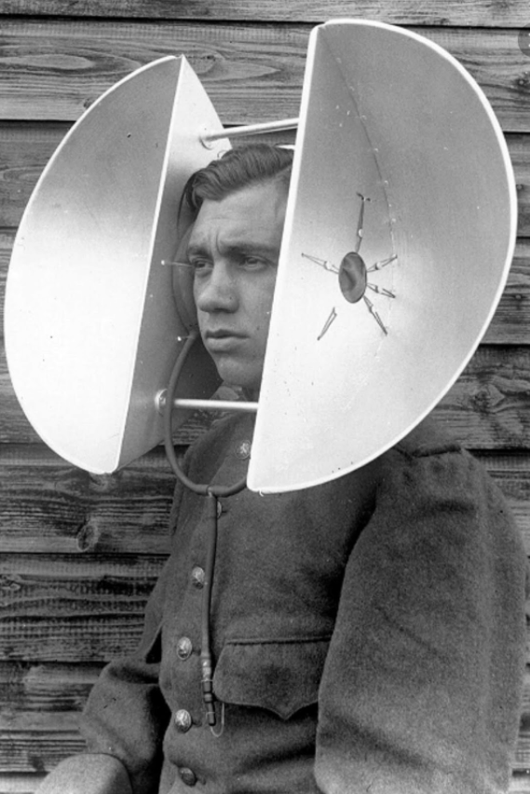
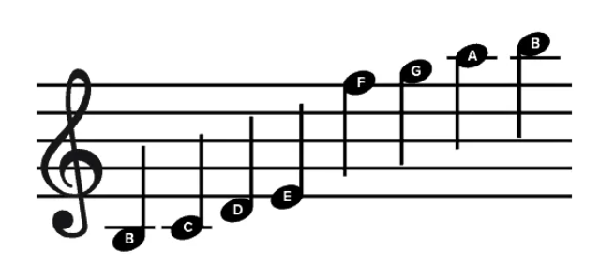
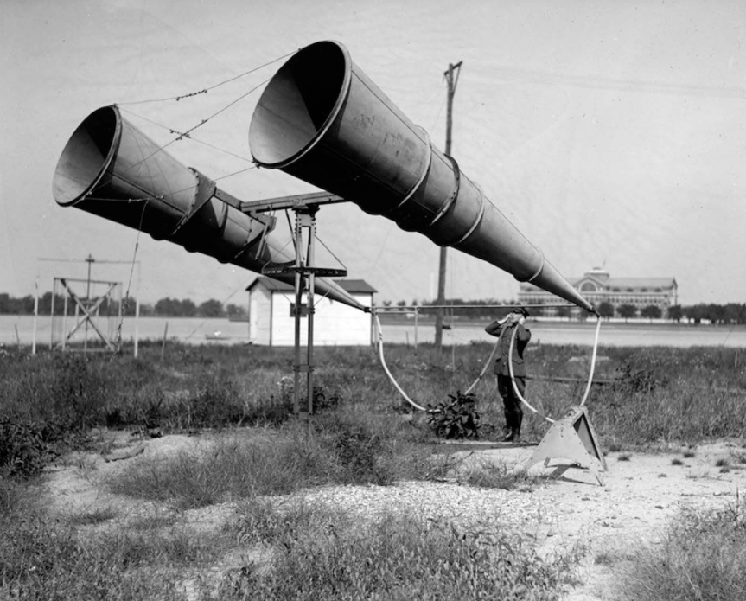
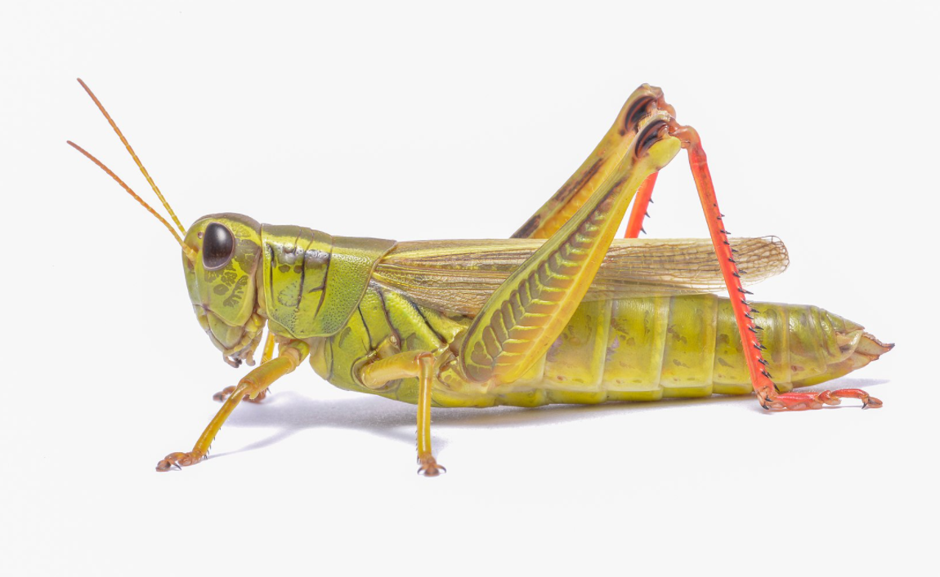
Some ideas which you could research yourself
What’s the highest or lowest note ever sung by a human ?
What is ultrasound and what is it used for ?
What’s going on in these old photos ?
How do crickets and grasshoppers use sounds ?

Slide 10
When searching online…
Research answers from more than one website.
Are you regularly finding the same results, or are you finding differences ?
Be aware that some of the things you see or read on the internet are someone’s opinion, and not always fact.

Slide 11
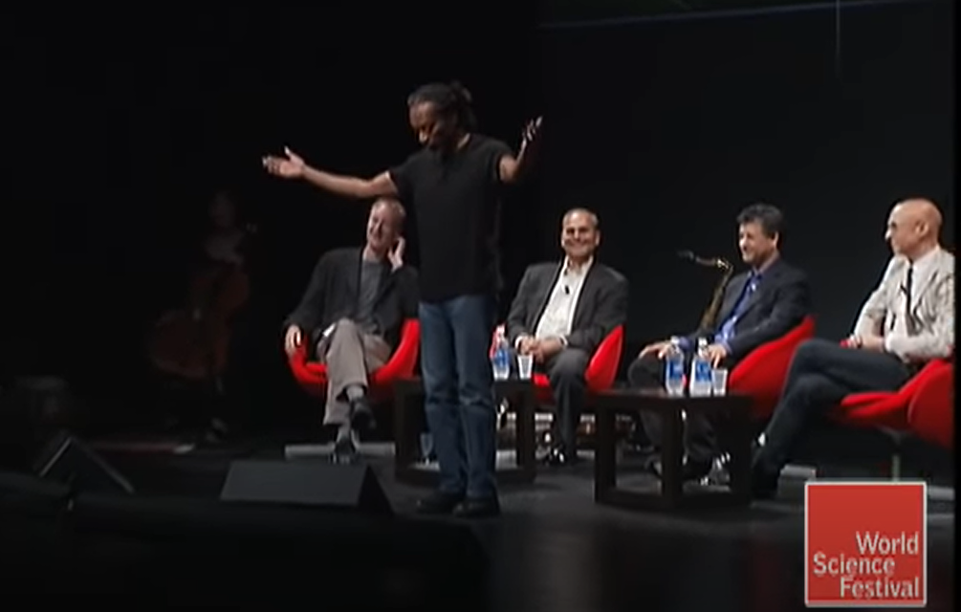
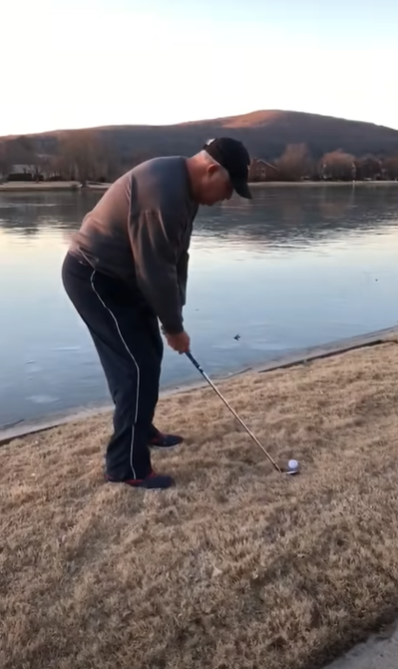
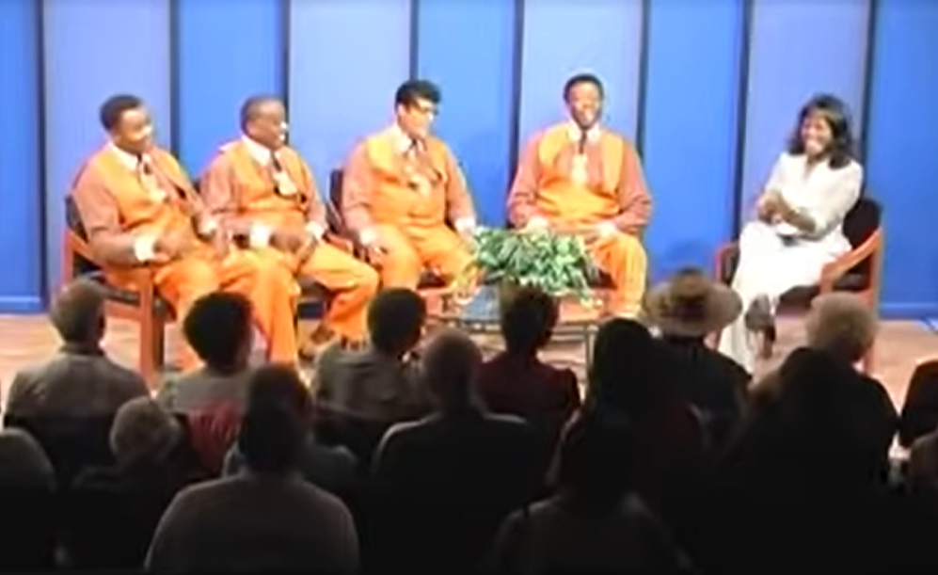
JUST FOR FUN !
The Power
of
The Pentatonic Scale
Male Quartet Group
Golf Ball Hitting Ice

Slide 12
THANKS!
I hope you enjoyed the lesson.
Any questions?
Send Mr. Fletcher a message on Dojo

