Slide 1
Science Week

Slide 2
Here at Heamoor we love Science and we love Science Week!

Slide 3
What did we do last time?
Chemistry

Slide 4
Science Week
physics
chemistry
biology

Slide 5
So what’s happening this week?

Slide 6
Physics
Physics is the study of matter.
It looks at what stuff is made from and how it interacts with the things around it.

Slide 7
Physics
Physics is the study of matter AND how it moves.
Why do we stay on planet Earth (gravity)?
What happens when I drop something (gravity)?

Slide 8
Physics
Physics is the study of matter, how it moves and ENERGY!
light
waves
astronomy
sound
motion

Slide 9
Ask questions
Experiment
Explore
Record
Have fun
Learn
You will:

Slide 10
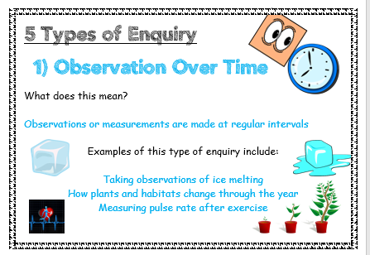
Remember, as well as working Scientifically, you will also be completing at least one of the 5 Types of Enquiry!
Can you remember what the 5 Types of Enquiry are?

Slide 11
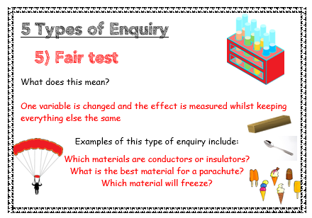
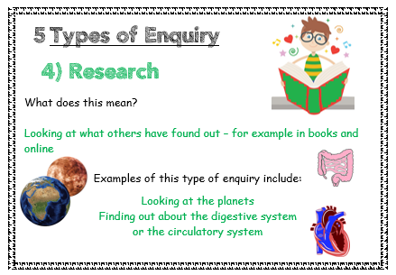
Can you remember what the 5 Types of Enquiry are?

