Slide 1
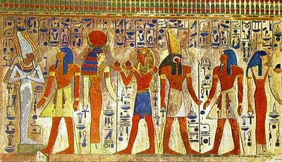
Year 3 Autumn Term 2018
Way back when…
Ancient… that’s old right?
Outcomes for the Term
1. First mini project –
‘’Oh Mummy!’’
The children will be learning about the mummification process and will mummify their own tomato.
2. Second mini project–
“Can you read me?’’
With their new found knowledge of hieroglyphics, the children will make their own papyrus scroll paper and use this to write a short note for someone else in hieroglyphics.
3. Third mini project-
‘’An ancient Egyptian’s best friend!’’
Following on from learning about ancient Egyptian artefacts, the children will design and create their own ancient Egyptian jewellery.
4. Final project-
‘’The time traveller’s… book’’.
The children will imagine they have just travelled back in a time machine from ancient Egypt. The children will create a scrapbook of their adventures. These scrapbooks will be showcased on our class library bookshelf for all to read.
Project Launch – The ‘Hook’
Egyptian picnic.
The children will take a trek back through time and dine like Pharaohs and Goddesses. Way back when… the finest fruits were only served to those of the highest power.
Trips and Experiences
Visits –
Royal Cornwall Museum (ancient Egypt display).
Penlee House (archaeology workshop).
Environment – Classroom
In Green class there will be one display and display table that will be updated with children’s learning based around our theme ancient Egypt.

